Slide 1
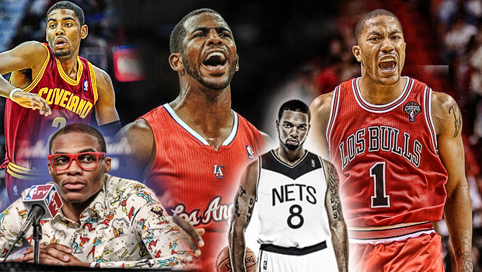
BASKETBALL
Point guards in the nba

Slide 2
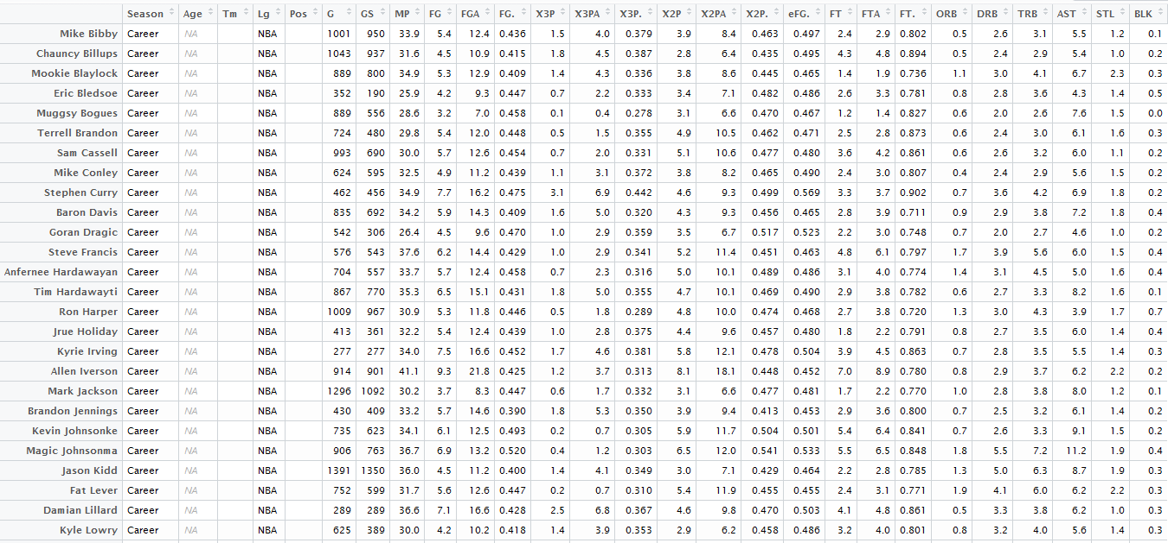
DATASET

Slide 3
GOAL
Investigate career statistical averages for point guards of the past and present
Find any underlying patterns that occur in the point guard position
Make solid statements about certain point guards with evidence to back it up

Slide 4
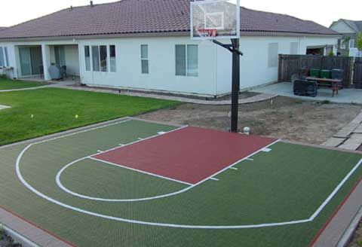
BASKETBALL TERMINOLOGY
Assist
3-pointer
Turnover
Point Guard
True Point Guard
Scoring Point Guard

Slide 5
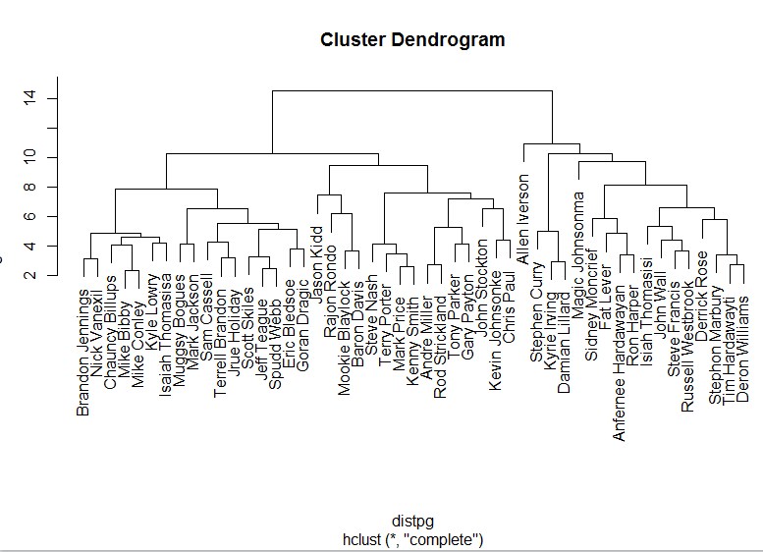
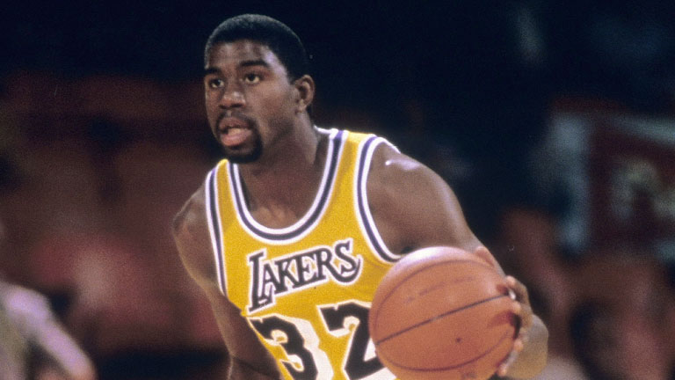

HIERARCHICAL CLUSTERING
Complete linkage gave most clear-ish results
There are about 3 major groups
Allen Iverson and Magic Johnson jump out
Scorers, True Point Guards, Average Point Guards
Misclassifications:
Deron Williams

Slide 6
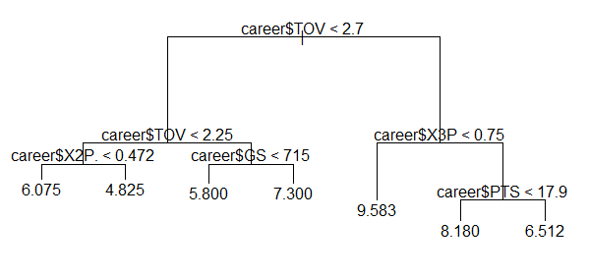
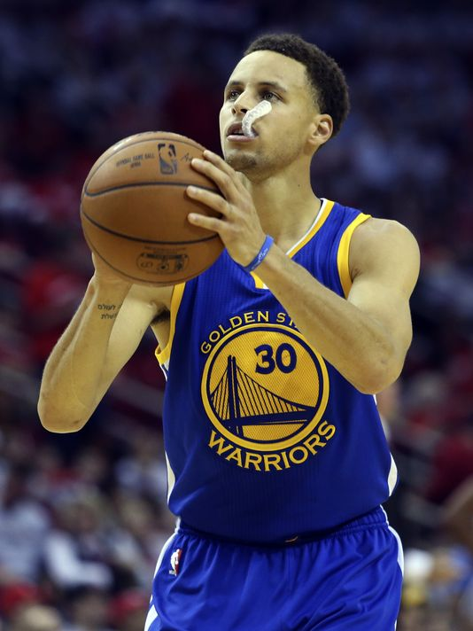
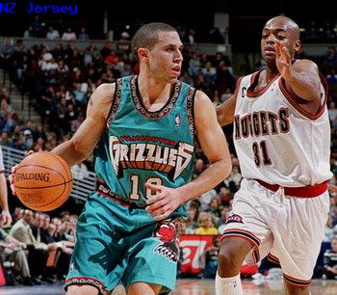
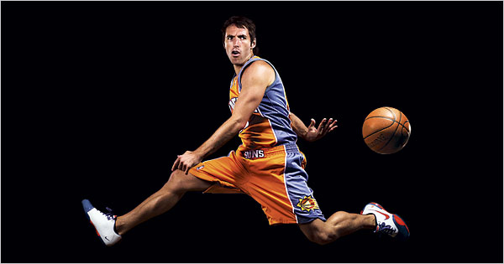
Regression tree
AST Decision Tree
The more you turn the ball over, the more assists you have
The less amount of field goals you get, the more assists you get
True PG vs. Scoring PG

Slide 7
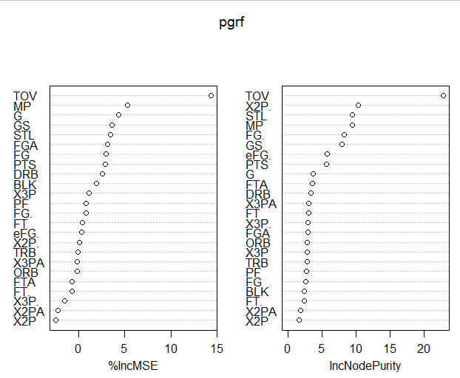
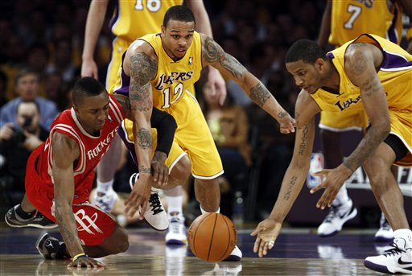
RANDOM FORESTS/BAGGING
Plot of variable importance for AST
We can see that TOV is very important
Solidifies our statement from previous slide: “The more turnovers you have the more assists you have”

Slide 8
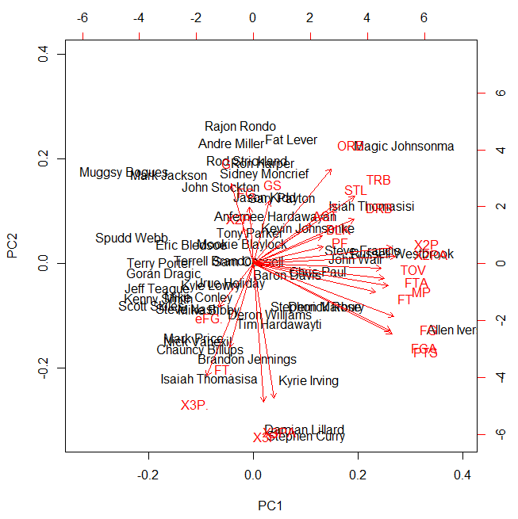
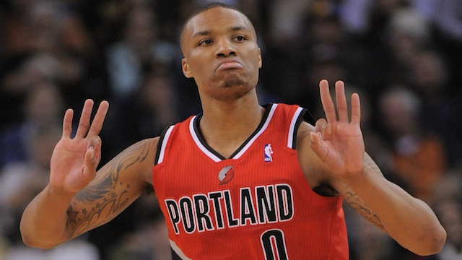
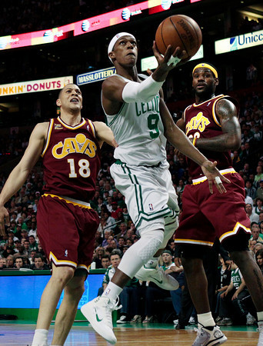
PRINCIPAL COMPONENT ANALYSIS
Majority of the varibles do poorly in PC2
3-Points made and attempted
Damian Lillard and Stephen Curry score very high in this variable
Allen Iverson Does well in a lot of categories
Magic Johnson, Rajon Rondo get a lot of rebounds

Slide 9
CONCLUSION
Point Guards have more assists if they have more turnovers
Point Guards who have less assists usually have more points
Iverson was the best at a lot of different things
There are scoring point guards and play-making point guards
3-point shooters and lay-up experts

